Slide 1
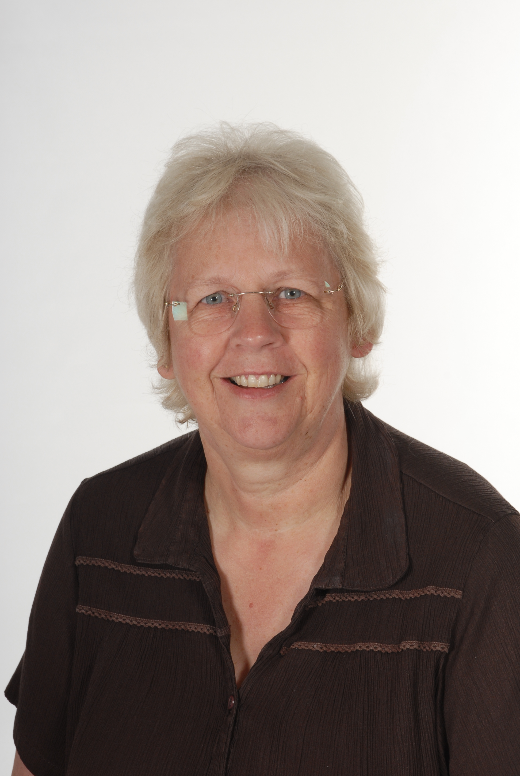
New Milton Junior School Governing Body
Governors are a voluntary body of people who guide and support the strategic direction of the school. They are members of the school team and their contribution to the running of the school is highly valued.
School Governing Body The instrument of government states that the governing body shall consist of:
• 2 parent governors
• 1 local authority governor
• 1 staff governor
• 1 headteacher
• 2 co-opted governors
The role of the governing body is a strategic one, its key functions are to:
• Set the aims and objectives for the school
• Set the policies for achieving those aims and objectives
• Set the targets for achieving those aims and objectives
• Monitor and evaluate the progress the school is making towards achievement of its aims and objectives
• Be a source of challenge and support to the headteacher (a critical friend)
Anne Pritchard
Chair of Governors – Local Authority
Committees – Resources, School Improvement
Date Appointed: 01.09.2008
Term of Office: Start 08.07.2019 end date 07.07.27
Governance roles in other educational institutions: None

Slide 2
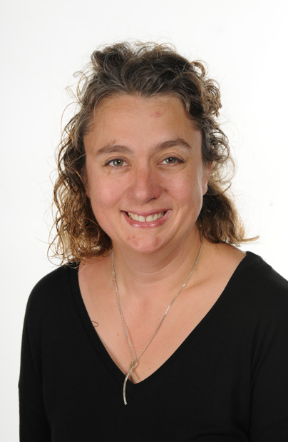
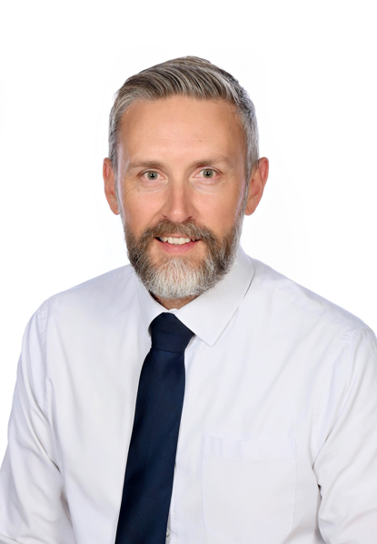
Sam Boothby
Co-opted Governor
Committees – Resources
Date Appointed: 01.12.2015
Term of Office: Start 01.12.2015 end date 02.10.2027
Governance roles in other educational institutions: None
Tom Chappell
Staff Governor
Committee – School Improvement
Date Appointed: 08.07.2015
Term of Office: Start 08.07.2019 end date 07.07.2027 Governance roles in other educational institutions: None

Slide 3
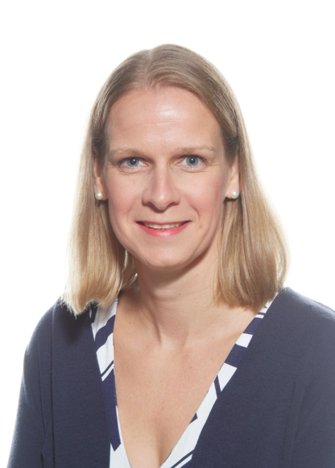
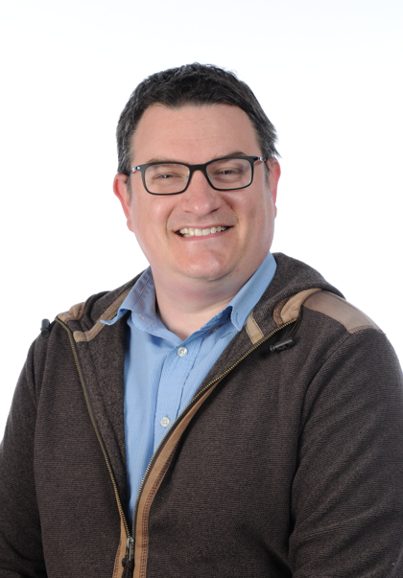
Jo Corrigan
Co-opted Governor
Committee – School Improvement
Date Appointed: 06.12.2017
Term of Office: Start 06.12.2017 end date 05.12.2029 Governance roles in other educational institutions: None
John Creedy
Parent Governor
Committee – Resources
Date Appointed: 01.05.2020
Term of Office: Start 01.05.2020 end date 30.04.2024 Governance roles in other educational institutions: None

Slide 4
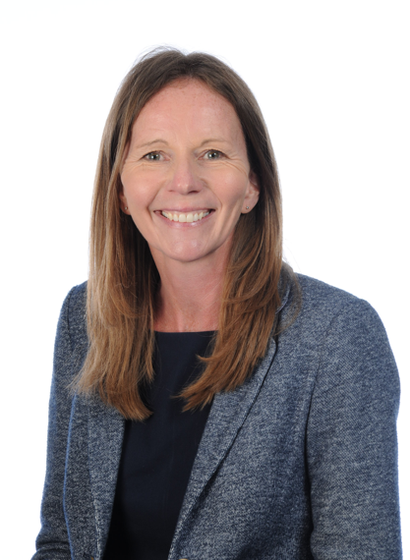
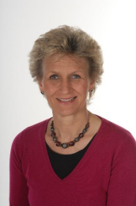
Emma Grinyer
Co-opted Governor
Committee – School Improvement
Date Appointed: 18.05.2020
Term of Office: Start 18.05.2020 end date 17.05.2026 Governance roles in other educational institutions: None
Angie Lilley
Co-opted Governor
Committee – Resources
Date Appointed:08.07.2015
Term of Office: Start 08.07.2019 end date 07.07.2027 Governance roles in other educational institutions: None

Slide 5
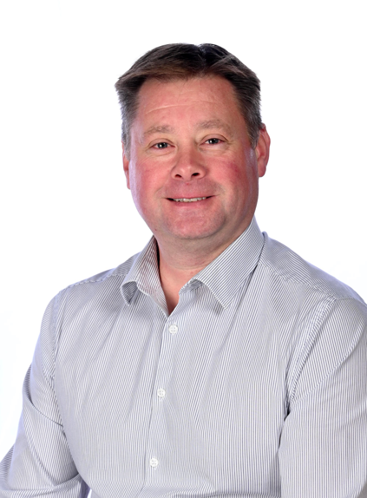
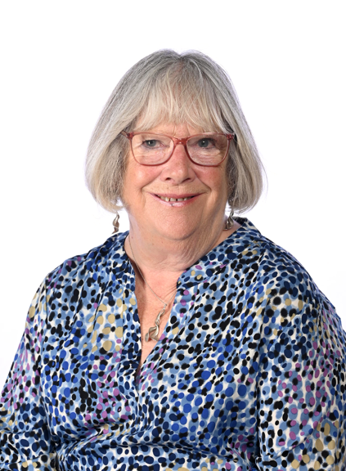
Simeon Woodcraft
Co-opted Governor
Committee – School Improvement
Date Appointed: 18.05.2016
Term of Office: Start 18.05.2016 end date 17.05.2026 Governance roles in other educational institutions: YES- Chair of Governors at New Milton Infant School.
Christina Lewis
Co-opted Governor
Committee – School Improvement
Date Appointed: 09.10.2023
Term of Office: Start 09.10.2023 end date 08.10.2027 Governance roles in other educational institutions: None

Slide 6
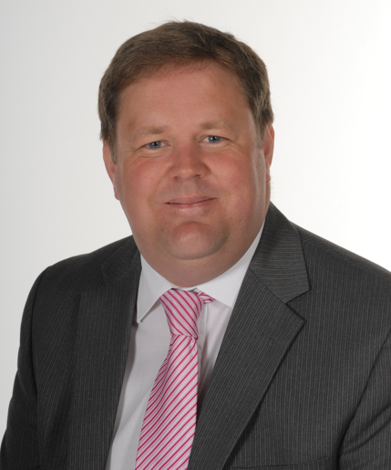
Lauren Perkins
Parent Governor
Committee –
Date Appointed: 13.11.2025
Term of Office: Start 13.11.25 end date 12.11.29
Governance roles in other educational institutions: None
Kelvin Geary
Headteacher
Committee – Resources , School Improvement
Date Appointed: 08.07.2015
Term of Office: Start 08.07.2015 - present
Governance roles in other educational institutions: None

