Slide 1
Let’s Write

Slide 2
A Child of Books

Slide 3

A Child of Books - Oliver Jeffers/Sam Winston - YouTube

Slide 4
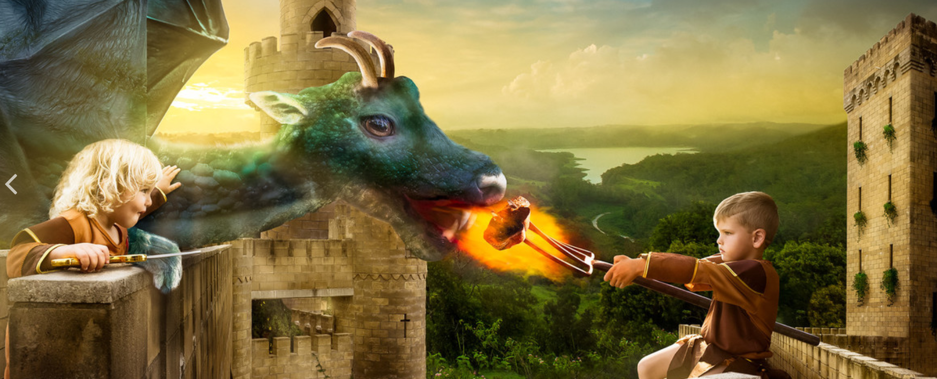

Slide 5
Story starter!
The King had known that the gift he presented to his children on their 5th birthday was dangerous. He was prepared to take the risk of letting them own a pet dragon, however. One day, the twins would rule the kingdom together, and they would need all the help they could get. No-one could deny that a dragon was a powerful ally!
Before that day, though, the children had much work to do. They had to train their dragon!
Question time!
Why has the King given his children a dragon?
Do you think it’s a wise decision?
What do you think the children will try and train their dragon to do?
Can you think of any strategies that the children might use to train their dragon?
Where do the children live?
Can you think of a good name for their kingdom?
Why do you think the children will need ‘all the help they can get’ when they come to rule?
Can you think of names for the children?
What is the boy feeding the dragon?
What do you think the girl is carrying?

Slide 6
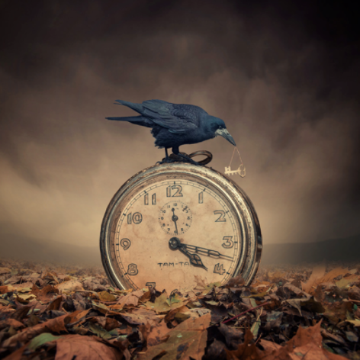

Slide 7
Question time!
What do you think the key is for? Why do you think the girl is so desperate to have it?
Why do you think the crow has taken the key?
How did the clock get there? Is it significant in the story?
What do you think the crow is thinking?
Where have all the leaves on the ground come from?
Story starter!
She had been chasing it all day. Now, the crow had it.
Time was ticking. Time was running out. She tiptoed towards the creature, seeing the precious key it held precariously in its sharp, cruel beak. It let out an irritating, throaty cackle, its soot-black wings ruffling gently as it manoeuvred itself on top of the clock; it was ready to take flight.
Knowing she might only have a few seconds before her opportunity disappeared, she took another cautious step forward. Time seemed to slow, her body tingled in excitement and her heart thudded in her chest. It was now or never…
Can you continue the story?

Slide 8
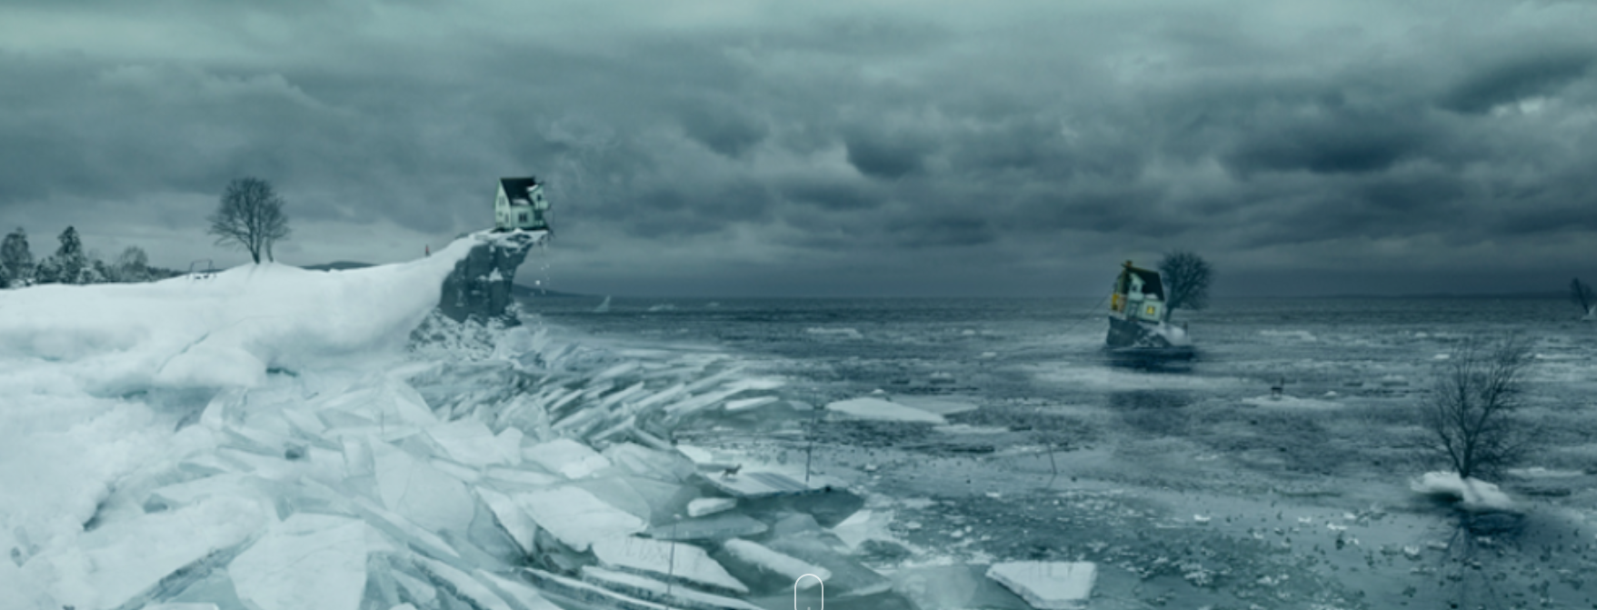

Slide 9
Story starter!
It was winter.
The thunder rumbling overhead seemed to taunt the young girl as she watched in horror while half of her home drifted away across the merciless, half-frozen sea.
She had awoken minutes earlier, disturbed from her sleep by the most appalling noise. It sounded as if a tree were being torn apart by giants, as if the Gods above were screaming at each other in a wild rage. She thought it was the end of the world. Perhaps it was. For her anyway.
In only her pyjamas, she stood on the edge of her ruined home, her toes dangling over the edge of the splintered floor, shivering in the harsh wind as it seemed to touch her skin like the kiss of some icy demon. She screamed at the top of her voice in despair and frustration, almost pleading with her frost-drenched surroundings to bring them back to her. She could see them. They were waving and shouting to her in return.
In front of her she could see the giant, drifting shards of ice, their edges sharp like Samurai swords. They knocked into each other as they were swept by the tide, reminding her of some cruel jigsaw that couldn’t be solved. She knew she could not reach them…
Can you continue the story of the girl and her home that had broken in two? Who was it she was waving to?
What had caused the ice to break? Would she manage to reunite with the people drifting away?

Slide 10
Or… decide upon your own stimulus: you
might have a picture, object or an idea
of your own….. and write away!

Slide 11
If you would like to share your writing
with me, I would love that. However, for
now… I would like you to only to submit
ONE sentence each time.
Choose one sentence that you believe to
should be celebrated … a little
like how I pick one in my
‘Books Glorious Books’ weekly shares.

Slide 12
To share your ONE sentence, please email:
imagine@newmiltonjuniorschool.co.uk

