Slide 1
Let’s Write 2

Slide 2
Have a look at any of the
images below.
Can you write a short
story or a diary entry or description
of the exact moment you can see?

Slide 3
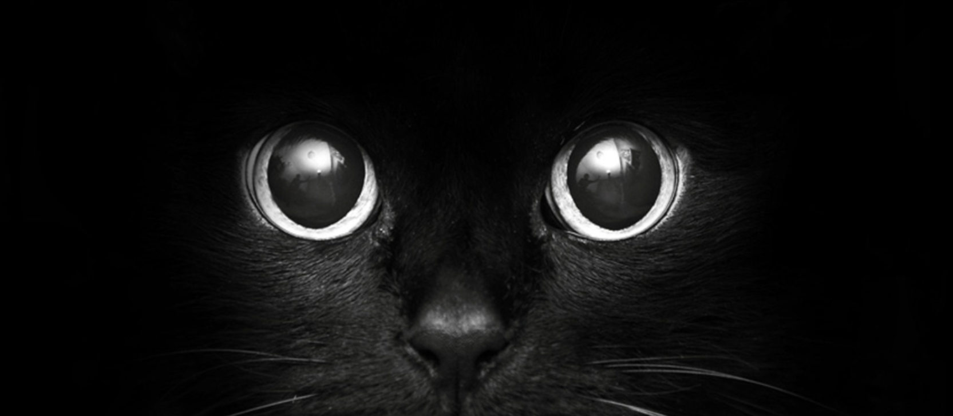

Slide 4
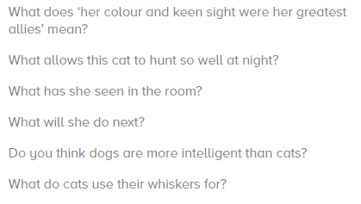
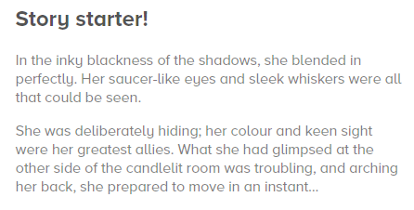

Slide 5


Slide 6
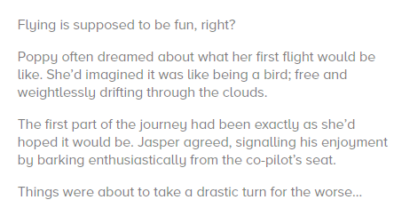
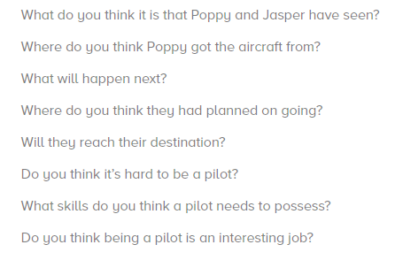

Slide 7


Slide 8
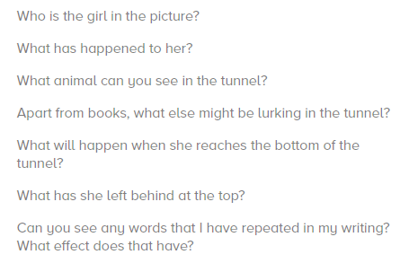
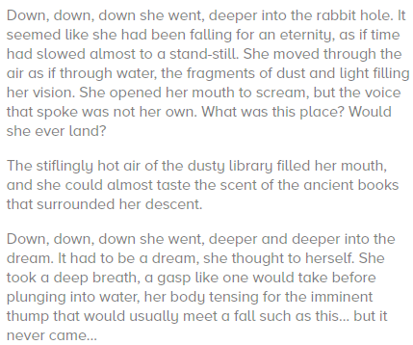

Slide 9
Or… decide upon your own stimulus: you
might have a picture, object or an idea
of your own….. and write away!

Slide 10
If you would like to share your writing
with me, I would love that. This time, submit
your whole piece, highlighting
ONE sentence that you believe
is FABULOUSLY effective!

Slide 11
To share your writing, please email:
imagine@newmiltonjuniorschool.co.uk

